Slide 1
COMP 41400 Multi-Agent Systems (MAS) Lectures 9 & 10 Belief Desire Intention Architectures
Professor Gregory O’Hare,
Principal Investigator CONSUS (Crop OptimisatioN through Sensing, Understanding & viSualisation),
School of Computer Science
University College Dublin (UCD)

Slide 2
Belief Desire Intention Architectures
One particular Architecture that has been employed in the
development of Reflective Systems is that of the Belief
Desire Intention (BDI) Architecture.
The term BDI is attributed to Rao and Georgeff (1992).
The architecture models the reflective process in terms of the
interplay between these three mental attitudes.

Slide 3
Beliefs, Desires and Intentions
Let us consider these three mental attitudes:-
Belief : represents the information state of the agent,
those things it believes to be true at a given
instance;
Desire: represents the evaluative state of the agent
that is those things that the agent at a
given instance desires to bring about;
Intentions: represents those activities which the agent has
decided at some previous time are crucial
in achieving its goals in an adequate
or optimum manner;

Slide 4
Early DAI Environments
ABE (Erman et al 1988)
ARCHON (Wittig 1989)
CooperA (Sommaruga et al 1989)
MACE (Gasser et al 1987)
MADE (Wooldridge & O'Hare 1990)
Agent Factory (O'Hare 1992)
MCS (Doran et al 1991)
GBB (Hayes-Roth et al 1988)

Slide 5
Classes of Commitment
Elsewhere in the literature [RG92] it is recognised that varying
degrees of commitment may be exhibited by agents.
Rao and Georgeff [RG91], [RG92] identify three discrete points
on this commitment continuum, namely:
Blind Commitment,
Single-Minded Commitment and
Open-Minded Commitment.

Slide 6
Blind Commitment
Blind commitment is defined as the adherence
to a commitment until such time as the agent believes
it has achieved the commitment.

Slide 7
Single-Minded Commitment
Single-minded commitment represents a relaxation of
blind commitment in that the agent will not drop its
commitments unless it believes that they are no longer
achievable.
The computational overhead of assertaining whether a
given goal is achievable can be considerable.
Rao and Georgeff suggest that this can be achieved by
permitting belief revision but not goal revision.

Slide 8
Open-Minded Commitment
Open-minded commitment offers a further relaxation
in that an agent is willing to revise its goals and beliefs,
retaining commitments that are still compatable with its goals.

Slide 9
Communication within DAI
Communication is central to the development of any
satisfactory Multi-Agent System. Effective communication
is a prerequisite for achieving system coordination and
system coherence.
Werner [Wer89] has identified several discrete classes of
communication that occurs within Multi-Agent Systems.
These are:-
1. Complete abscence of communication;
2. Inter-Agent Signalling;
3. Message Passing;
4. Plan Passing;
5. Speech Acts;

Slide 10
Coordination
Coordination represents the problem or activity of
reconciling the actions of the individual agent with
those of the group or indeed organisation.
Since agents actions are derived from their goals and since
agents are frequently benevolant their will inevitably be
conflict.
Such interference can only be reconciled through
communication.

Slide 11
Coherence
System coherence involves ensuring that the overall
system performance is satisfactory

Slide 12
Absence of Communication
Sometimes communities of agents can achieve coherent
behaviour without explicit communication.
Geneserth Ginsberg & Rosenchein [GGR84] considered
this very issue in a seminal paper entitled Cooperation
without Communication.
Agents might have a prearranged regime for achieving their
goals and this is established a priori thus avoiding any need
for dynamic communication.
Alternatively they may infer each others plans based on
observations to date. This results in a prediction of agents'
behaviour [Ros85].

Slide 13
Agent Signalling
Inter-Agent activity can be sychronised through the
use of semaphore based technologies.
Semaphores offer a relatively simplistic communication
technique.
They utilise the standard, primitives of wait and signal and
are directly analogous to those techniques used within the
design of real-time languages and systems

Slide 14
Message Passing
Another very common means of inter-agent communication
is that of message passing.
Early work by Hewitt & Agha formulated a computational
paradigm based upon actor-based computation. Central to
this was the notion of message passing.
Message passing generally manifests itsself in many DAI
systems.

Slide 15
Plan Passing
This approach involves agents exchanging plans to one another. By so doing agents can anticipate the future directed actions of other agents.
One particular approach involves the exchange of Partial Plans. This approach called Partial Global Planning (PGP)
was expounded by Durfee and Lesser. Within PGP agents build partial and incomplete plans which they subsequently share to colleagues in order to identify potential improvements.
This approach unlike for example multi-agent planning allows
agents to interleave planning and actions. Thus based upon
future plans received agents can revise their plans and
subsequently perform actions based upon this. PGP
was employed with great effect in the DVMT system.

Slide 16
Essence of Speech Acts
The origins of Speech Act Theory can be
traced to the work of Austin [Aus62].
Two central characteristics associated with the basic
theory of Speech Acts are:-
1. That human utterances are viewed as actions in a
manner similar to physical operations that result in
the movement of a book for example. They too result in a
change in the state of the world.
2. That communication can be homogenised into a finite set
of Speech Verbs that can be used to as an effective medium
within which to communicate.

Slide 17
Speech Acts and State Change
It is not immediately obvious how Speech Acts result in a
change to the environment.
All utterances are viewed as being situated within a particular
context and each results in a revision to that very context.
The context is often viewed as the aggregation of the mental
states of the participants namely the speaker and the hearer.
Such a mental state includes their Beliefs, Desires and Intentions.

Slide 18
A Pragmmatic Theory of Speech
We can thus view a pragmatic theory of speech as a function
which takes a set of all utterances of a given language lets say L
and an associated set of Contexts within which these can be
expressed lets say C and derives the new context.
Thus
Speech_Function : L x C -> C

Slide 19
Speech Act Actions
Austin also identified three discrete classes of action associated
with any given utterance:-
• Locutionary Acts :- which is performed by simply uttering a
syntactically correct phrase;
• Illocutionary Acts :- which is performed via a performative
verb examples include tell, inform, ask,
instruct, demand. Each verb has an
associated illocutionary force. Austin
identified some 1,000 such verbs in
English;
• Perlocutionary Acts:- is the bringing about of an effect on the
hearer of the utterance;
Speech acts generally refer to the illocutionary act.

Slide 20
Speech Acts and Austin
Austin noted that certain utterances involved not merely the
assertain of facts but rather the performance of associated
action(s). These utterances are termed performatives and he
noted that these like physical actions are prone to failure.
The conditions that must exist for successful completion were
called felicity conditions. Three key conditions are:-
1. There must be an accepted procedure for the performative
and the circumstances and individuals must be specified for
this procedure.
2. This procedure must be executed correctly and completely.
3. The act must be performed in a sincere manner and any
associated or implied behaviour honoured.

Slide 21
Objects versus Agents
Numerous Authors & Researchers have debated the differences and similarities between Objects and Agents;
Agents are autonomous. An object does not exhibit control over its behaviour; methods are made available for invokation as and when desired; Agents do not invoke methods but make requests;
Objects have nothing to say about differing deductive models like reactive, pro-active or social abilities
Agents are each considered to have their own thread of control. In standard object systems there is merely one thread; However some concurrent object based programming languages starting to emerge;

Slide 22
Active Objects
Active Objects blur the distinction;
Active objects have their own thread of control and can in some senses be considered autonomous;
They exhibit some behaviours without actually being operated upon;

Slide 23
COMP 41400 Multi-Agent Systems (MAS) Lectures 9 & 10 Belief & Commitment Management expemplified via Agent Factory
Professor Gregory O’Hare,
Principal Investigator CONSUS (Crop OptimisatioN through Sensing, Understanding & viSualisation),
School of Computer Science
University College Dublin (UCD)

Slide 24
Agent Factory Layers
A cohesive framework that supports a structured approach to the development and deployment of multi-agent systems.
Agent Factory Methodology
Agent Factory Development Environment
Agent Factory Run-Time Environment
AF-APL

Slide 25
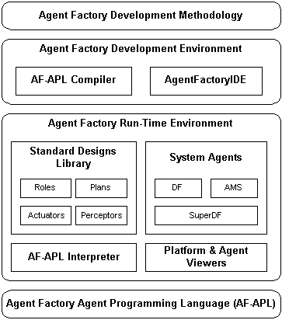
What is Agent Factory?
Organised over four layers:
Programming Language
Run-Time Environment
Development Environment
Software Engineering Methodology
Agent Factory is… “a cohesive framework that delivers structured support for the development and deployment of agent-oriented applications.”

Slide 26
What is Agent Factory?
Organised over four layers:
Programming Language
Declarative
Formalised through a Multi-modal logic
Agent-specific Constructs
Run-Time Environment
Development Environment
Software Engineering Methodology
Agent Factory is… “a cohesive framework that delivers structured support for the development and deployment of agent-oriented applications.”

Slide 27
What is Agent Factory?
Organised over four layers:
Programming Language
Run-Time Environment
Distributed
FIPA Compliant
Agent Platforms + Infrastructure
System Agents: AMS + DF
Development Environment
Software Engineering Methodology
Agent Factory is… “a cohesive framework that delivers structured support for the development and deployment of agent-oriented applications.”

Slide 28
What is Agent Factory?
Organised over four layers:
Programming Language
Run-Time Environment
Development Environment
AF-APL Compiler
Netbeans & Eclipse Plugins
VIPER – Protocol Editor
Software Engineering Methodology
Agent Factory is… “a cohesive framework that delivers structured support for the development and deployment of agent-oriented applications.”

Slide 29
What is Agent Factory?
Organised over four layers:
Programming Language
Run-Time Environment
Development Environment
Software Engineering Methodology
Agent Factory is… “a cohesive framework that delivers structured support for the development and deployment of agent-oriented applications.”

Slide 30
What is Agent Factory?
Organised over four layers:
Programming Language
Run-Time Environment
Development Environment
Software Engineering Methodology
Implemented in Java
Personal Java, J2ME and J2SE-Compliant
Deployed on PDAs / PCs
Open Source:
Downloadable from http://agentfactory.sourceforge.net
Agent Factory is… “a cohesive framework that delivers structured support for the development and deployment of agent-oriented applications.”

Slide 31
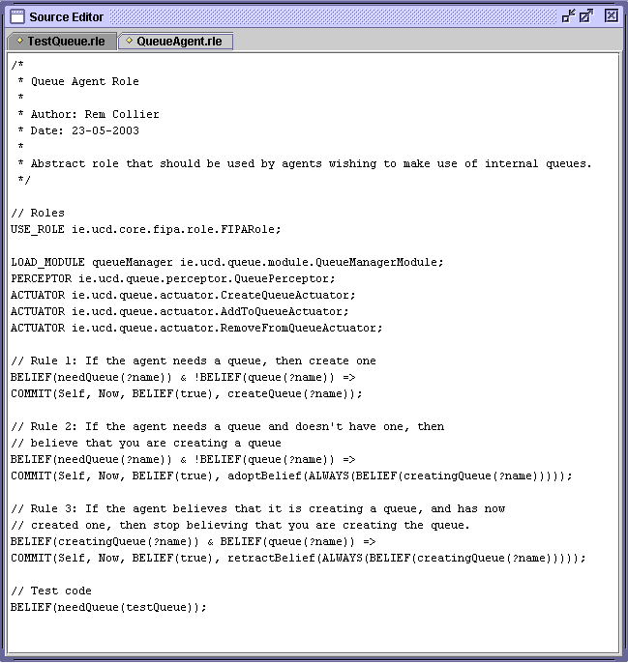
AF-APL
AF-APL Programs define:
Actuators
Perceptors
Modules
Commitment Rules
Initial Mental State

Slide 32
Executing AF-APL
AF-APL is executed on a purpose-built agent interpreter.
The agent class is loaded into the interpreter when the agent is created.
Control functions can be used to suspend, resume, and terminate the operation of the agent.
The interpreter processes the agent program by analysing the model of the environment (beliefs) and making decisions about how to act (commitments).
Two problems arise from this:
How to ensure that the model of the environment is up-to-date?
How to make the decision about how and when to act?
These problems are known as the belief management and commitment management problems respectively.

Slide 33
Belief Management
Belief Management = Belief Update + Belief Query
Belief Update.
Dynamic Environment -> Transitory beliefs
Persistence can be supported through temporal operators (eg ALWAYS, NEXT)
Belief update = gathering perceptions + updating the temporal beliefs.
Belief Update
Sensor Data
Perception
Current Beliefs
Temporal Update
Temporal Beliefs

Slide 34
Belief Management
Belief Management = Belief Update + Belief Query
Belief Query.
Beliefs = Facts + Implications (Belief Rules).
Resolution-based reasoning on current beliefs
Belief Update
Sensor Data
Perception
Current Beliefs
Belief Rules
Temporal Update
Temporal Beliefs
Belief Query
Belief Queries

Slide 35
Representing Beliefs in AF-APL
AF-APL supports three forms of belief:
Current Beliefs. Beliefs that are true at the current time point.
Temporal Beliefs. Beliefs that persist over more than one time point.
Belief Rules. Rules that define inferences that can be made on the current beliefs.
In AF-APL a belief is represented as a first-order structure enclosed within a BELIEF operator:
BELIEF(happy(rem)) – a belief that rem is happy
BELIEF(likes(?person, beer)) – a belief that some person likes beer
BELIEF(bid(fred, 50)) – a belief that fred has bid 50
These beliefs are current beliefs and apply only at the current time point. As a consequence, they are wiped at the start of each iteration of the AF-APL interpreter.

Slide 36
Temporal Beliefs
ALWAYS – the belief is a current belief and will persist until the temporal belief is dropped.
ALWAYS(BELIEF(happy(greg))) – always believe that greg is happy
UNTIL – the belief is a current belief and will persist until either the temporal belief is dropped or the associated condition is satisfied.
UNTIL(BELIEF(drinking(wine,greg)), !BELIEF(available(wine))) – believe that greg is drinking wine until do not believe that there is wine available.
NEXT – the belief will be a current belief at the next time point.
NEXT(BELIEF(finished(wine))) – at the next time point belief that the wine is finished.
These beliefs are maintained until they are explicity dropped.

Slide 37
Belief Rules
Belief Rules define inferences that can be made over the current beliefs of the agent.
They take the form of logical implications:
BELIEF(likes(?food)) & BELIEF(has(?food)) => BELIEF(want(?food))
BELIEF(has(rem, icecream)) => BELIEF(happy(rem))

Slide 38
Commitment Management
It is formed from a number of sub-processes which implement a set of strategies that specify how an agent:
Adopts new commitments.
Maintains its existing commitments
Refines commitments to plans into additional commitments.
Realises commitments to action.
Handles failed commitments.
A Commitment Management Strategy is a specific set of strategies that can be employed by an agent.
e.g. blind commitment, single-minded commitment, social-minded commitment.
The default strategy in Agent Factory is single-minded commitment.
An agent maintains a commitment so long as it believes it is still acheivable.

Slide 39
Commitment Maintenance
Commitments are maintained using a maintenance condition that is associated with each commitment.
E.g. BELIEF(has(?food)) => COMMIT(Self, Now, BELIEF(true), eat(?food))
This condition outlines what must remain true for the agent to keep the commitment (like terms and conditions and a contract).
In the above example, the maintenance condition will always be true. This is sometimes known as blind commitment.
The maintenance condition is evaluated at each time point.
If the condition becomes false at any time point, then the commitment is said to have “failed”.

Slide 40
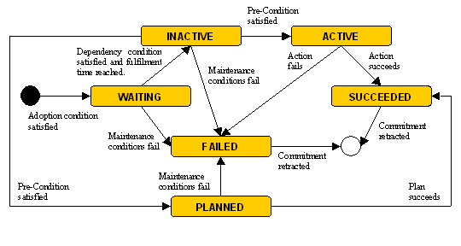
Commitment States

Slide 41
Commitment Structure Example
Gregory,
2005/01/20-8:00:00,
BELIEF(true),
SEQ(doA, doB),
INACTIVE

Slide 42
Commitment Structure Example
Gregory,
2005/01/20-8:00:00,
BELIEF(true),
SEQ(doA, doB),
PLANNED
Gregory,
2005/01/20-8:00:00,
BELIEF(true),
doA,
INACTIVE
Gregory,
2005/01/20-8:00:00,
BELIEF(true),
doB,
WAITING

Slide 43
Commitment Structure Example
Gregory,
2005/01/20-8:00:00,
BELIEF(true),
SEQ(doA, doB),
PLANNED
Gregory,
2005/01/20-8:00:00,
BELIEF(true),
doA,
ACTIVE
Gregory,
2005/01/20-8:00:00,
BELIEF(true),
doB,
WAITING

Slide 44
Commitment Structure Example
Gregory,
2005/01/20-8:00:00,
BELIEF(true),
SEQ(doA, doB),
PLANNED
Gregory,
2005/01/20-8:00:00,
BELIEF(true),
doA,
SUCCEEDED
Gregory,
2005/01/20-8:00:00,
BELIEF(true),
doB,
WAITING

Slide 45
Commitment Structure Example
Gregory,
2005/01/20-8:00:00,
BELIEF(true),
SEQ(doA, doB),
PLANNED
Gregory,
2005/01/20-8:00:00,
BELIEF(true),
doB,
INACTIVE

Slide 46
Commitment Structure Example
Gregory,
2005/01/20-8:00:00,
BELIEF(true),
SEQ(doA, doB),
PLANNED
Gregory,
2005/01/20-8:00:00,
BELIEF(true),
doB,
ACTIVE

Slide 47
Commitment Structure Example
Gregory,
2005/01/20-8:00:00,
BELIEF(true),
SEQ(doA, doB),
PLANNED
Gregory,
2005/01/20-8:00:00,
BELIEF(true),
doB,
SUCCEEDED

Slide 48
Commitment Structure Example
Gregory,
2005/01/20-8:00:00,
BELIEF(true),
SEQ(doA, doB),
SUCCEEDED

Slide 49
Failure Example
Gregory,
2005/01/20-8:00:00,
BELIEF(true),
SEQ(doA, doB),
PLANNED
Gregory,
2005/01/20-8:00:00,
BELIEF(true),
doA,
ACTIVE
Gregory,
2005/01/20-8:00:00,
BELIEF(true),
doB,
WAITING

Slide 50
Failure Example
Gregory,
2005/01/20-8:00:00,
BELIEF(true),
SEQ(doA, doB),
PLANNED
Gregory,
2005/01/20-8:00:00,
BELIEF(true),
doA,
FAILED
Gregory,
2005/01/20-8:00:00,
BELIEF(true),
doB,
WAITING

Slide 51
Failure Example
Gregory,
2005/01/20-8:00:00,
BELIEF(true),
SEQ(doA, doB),
FAILED
Gregory,
2005/01/20-8:00:00,
BELIEF(true),
doB,
FAILED

Slide 52
Key AF-APL Agent Concepts
Agent = Mental State + Commitment Rules + Embodiment Config.
Mental State:
Beliefs. Subjective knowledge about the current state of the environment.
Commitments. Mental contract describing which activity, at what time, for whom, and under what conditions.
Activities may be either primitive actions or plans (SEQ, OR, PAR).
Commitment Rules:
Map situations (possible environment states) to commitments that should be adopted should the situation arise.
Embodiment Configuration
Perceptors. Computational units that convert raw data into beliefs.
Actuators. Computational units that define how to realise primitive actions.

Slide 53
Commitment Failure Handling
If any commitment fails, the failure handling strategy defines how the agent should respond to the failure.
In AF-APL, the strategy is simple:
The failure of a secondary commitment is passed to the parent commitment. The impact of this failure is assessed with respect to the parent commitment.
The failure of a commitment that has children causes the children to fail. There is no assessment here!
During the failure handling process, this strategy is applied recursively through the commitment structure.
This recursive process, while potentially computationally expensive, is essential to ensure the agent does not continue to try and fulfil commitments that are now redundant.

Slide 54
Commitment Realisation & Refinement
At some point in time, the agent will try to fulfill its commitments.
Commitments to action are fulfilled through actuator activation.
The agent finds the corresponding actuator and activates it.
If not corresponding actuator exists, then the commitment fails.
Commitments to plans are fulfilled through commitment refinement.
The agent adopts a set of secondary commitments that correspond to the activities specified in the plan.
Plan operators may be used to place an order on the achievement of these commitments.
We label the set of commitments adopted when fulfilling a primary commitment to be a commitment structure.

Slide 55
Representing Activities
Activities describe what the agent can do:
Actions. Primitive abilities that are directly executable by the agent.
Plans. A recipe that consists of a partially ordered set of activities.
AF-APL supports the definition of actions and explicit plans.
Actions are defined in the constructor of the associated actuator unit. The definition consists of a unique identifier (e.g. eat(?food) ), a pre-condition (e.g. BELIEF(has(?food)) ) and a post-condition (not used).
Explicit plans are defined within the activity field of a commitment. They take the form of a plan operator (SEQ or PAR for AF-APL) together with a list of activities that may be either additional plan operators or actions.
E.g. SEQ(PAR(boilWater, addCoffee), pourWater, PAR(addSugar, addMilk))

Slide 56
Commitment Adoption
Commitments are adopted as a result of the triggering of Commitment Rules.
A commitment rule defines a situation in which the agent should adopt a commitment.
E.g. BELIEF(has(?food)) => COMMIT(Self, Now, BELIEF(true), eat(?food))
Each of the commitment rules is checked during each iteration of the AF-APL interpreter.
If the situation (left-hand side) of any rule is evaluated to true, then the rule is said to have been triggered.
Whenever a rule is triggered, there exists (at least one) set of variable bindings.
Each set of bindings is applied to the commitment construct on the right-hand side of the commitment rule, and the corresponding primary commitment is adopted by the agent.

Slide 57
Agent Factory in Context I
A number of other Agent Development Tools exist:
LEAP (LEAP Consortium). Integration of JADE and ZEUS that is compliant with J2ME.
JADE (TILAB). FIPA-compliant Java API that supports the fabrication of reactive agents.
ZEUS (BT Labs). A graphical toolkit for creating deliberative agent designs, which when completed, are compiled into Java code, customised and finally, executed.
JACK (Agent-Oriented Software). Extends Java with agent-based concepts. JACK code is compiled into Java code and executed.
FIPA-OS (Emorphia). The first FIPA-compliant agent platform. Similar to JADE.

Slide 58
Agent Factory in Context II
Table 1. A Comparison of Agent Prototyping Environments
AF
LEAP
JACK
ZEUS
JADE
FIPA-OS
BDI
√
√
√
√
Mobility
√
√
√
√
White Pages
√
√
√
√
√
Yellow Pages
√
√
√
√
√
FIPA Compliance
√
√
√
√
√
Fabrication Mode
Design
Instance
Design
Instance
Design
Design
Inheritance
√
√
√
√
Construction
Graphical
Graphical
Graphical
Graphical
None
None
Visualization
Graphical
Graphical
None
Graphical
None
None
Integrated Methodology
√
√
√

Slide 59
Summary
Agent Factory:
Is a cohesive framework for the development and deployment of agent-oriented applications on J2ME-compliant devices.
Offers a visually intuitive development environment that:
Promotes design reuse.
Has strong links with Agent UML.
Delivers a rich set of tools to support the development and debugging of agent designs.
Provides a rich coupling between an Agent Development Methodology and the Agent Factory toolset.
Supports mobile agents.

Slide 60

Things to Do!
Read and take notes on pp 54-61 Wooldridge intelligent agents book;
Read and take notes on pp 76-80 Wooldridge intelligent agents book;

